Slide 1

Evaluation of Bias Adjustment of NEXRAD Rainfall for Use in Hydrologic Models
Kevin Rodberg
Science Supervisor
Resource Evaluation Section
5/25/2018

Slide 2
Objective
Evaluate and compare POR (1999-2016) gauge vs NEXRAD rainfall for rain gauges within the LWC.
Examine the relationship of gauge and NEXRAD data on a daily, weekly, bi-weekly, monthly, and yearly for the entire network and individual rain gauge stations.
Develop a correction method based on the relationship of matching rain gauge and NEXRAD data that can be applied across the LWC NEXRAD grid (4,464 pixels).

Slide 3
Why?
NEXRAD overestimates small rainfall, and underestimation of large rainfall relative to rain gauge network.
NEXRAD data is an important component in hydrologic model calibration.
Current NEXRAD data increase uncertainties in hydrologic models.

Slide 4
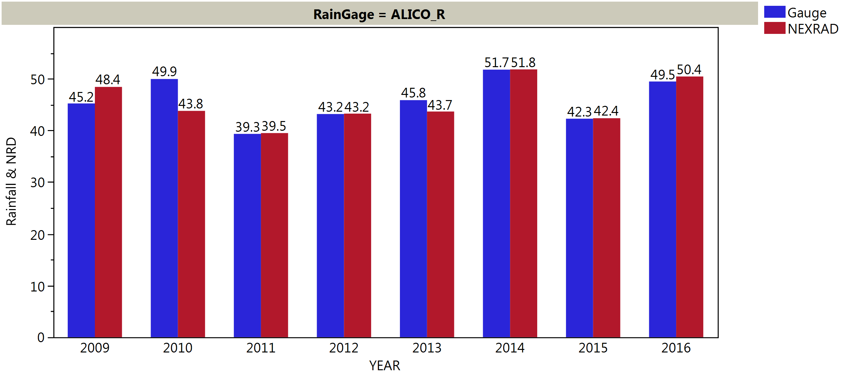
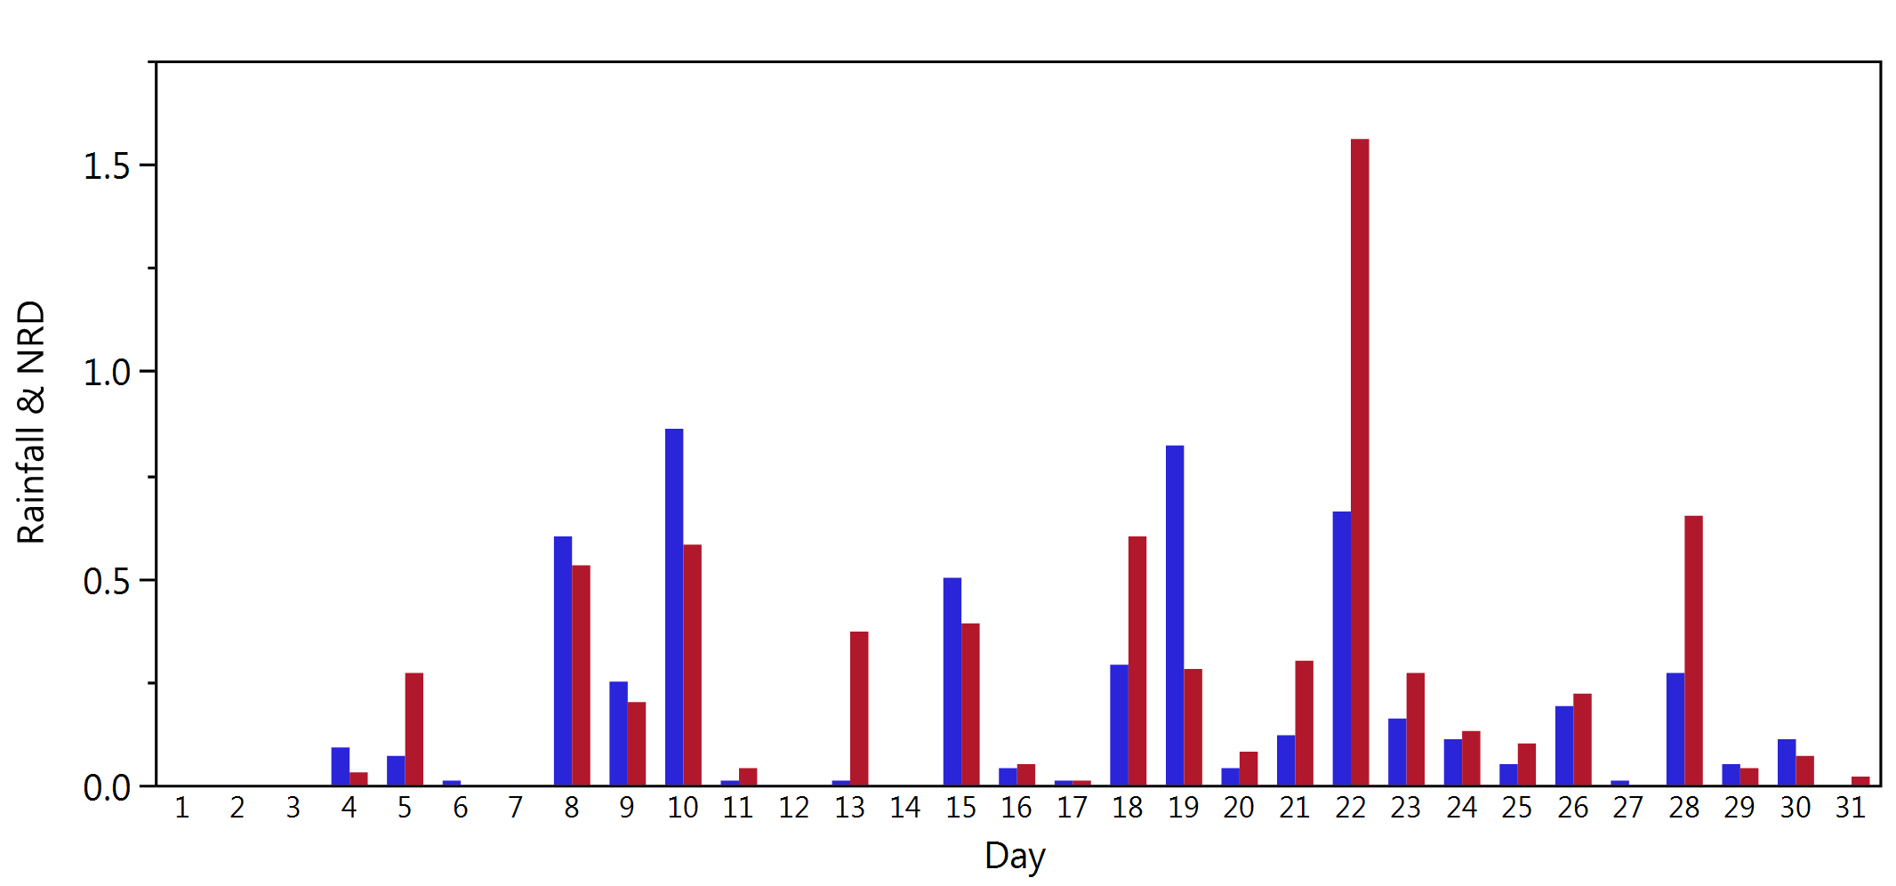
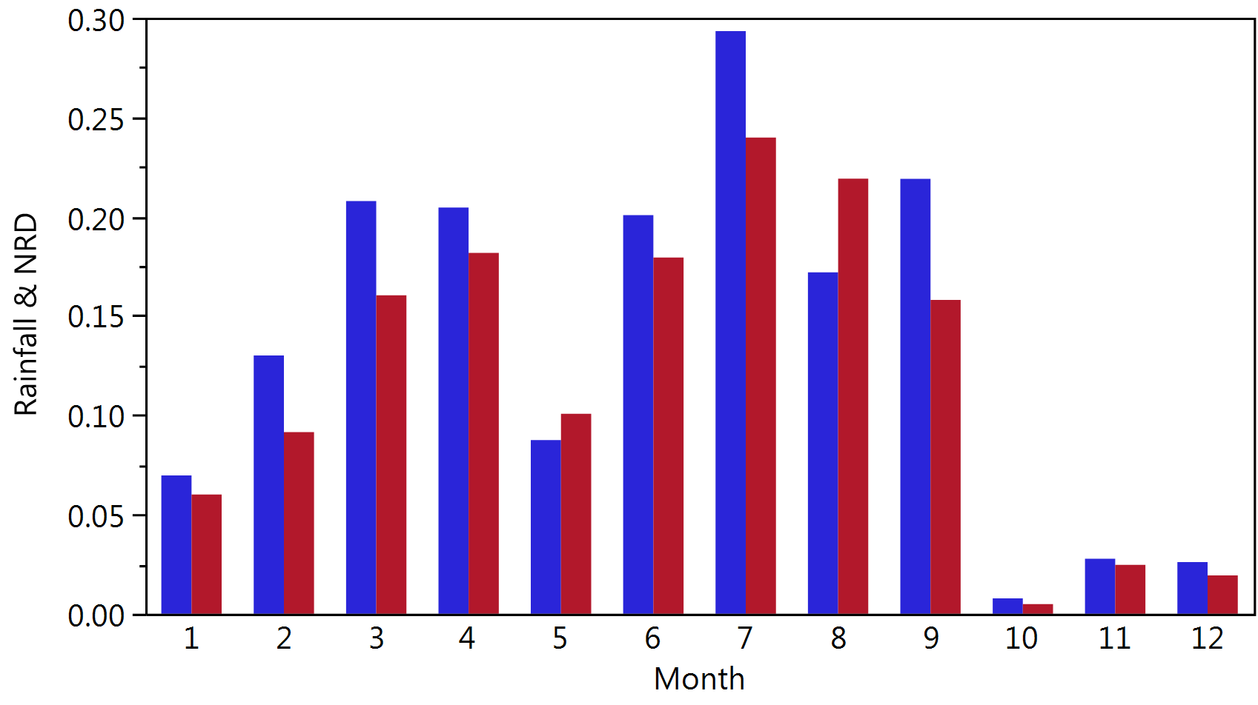
Comparison of NEXRAD pixel vs Rain Gauge
ALICO_R (2010)
ALICO_R (August/2010)
Notes:
This example shows how NEXRAD values deviate from associated rain gauge values

Slide 5
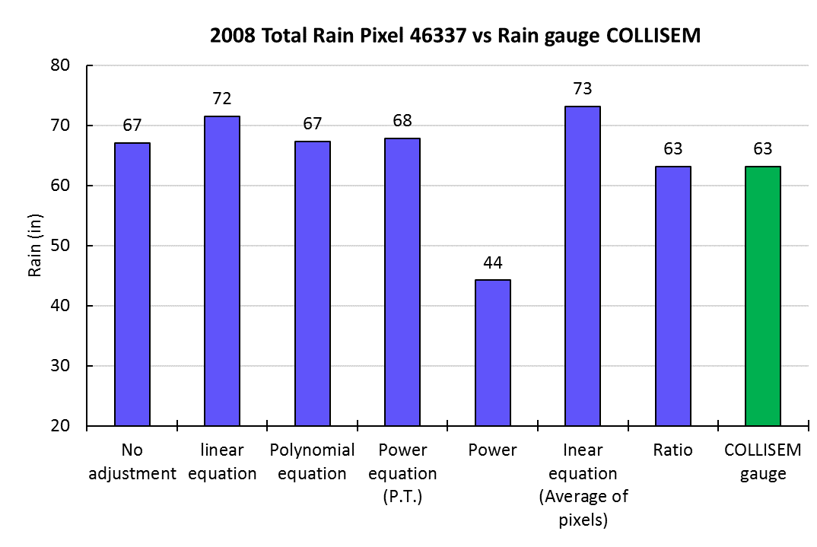
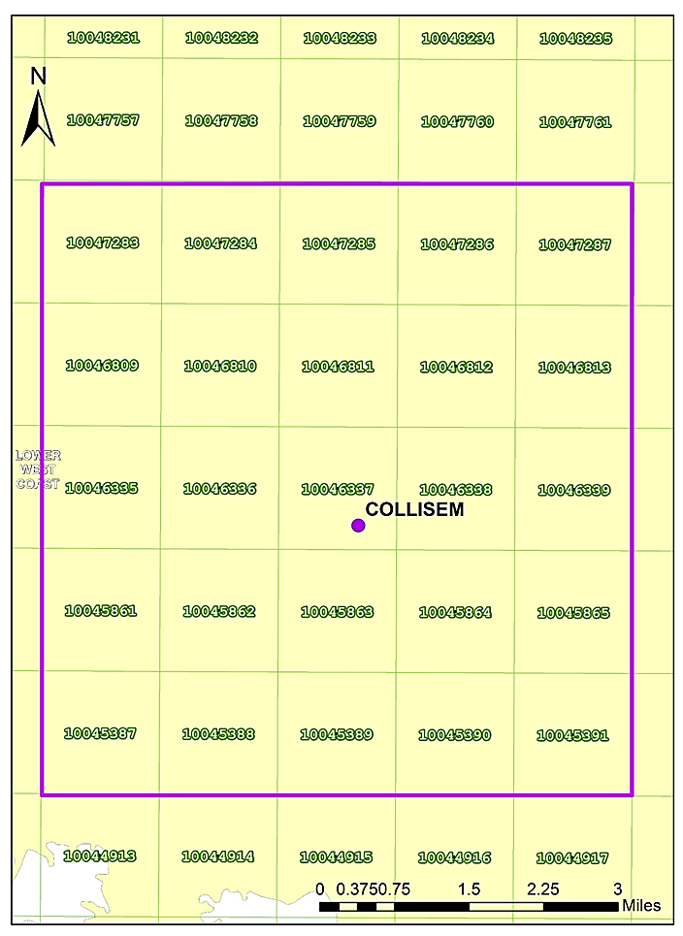
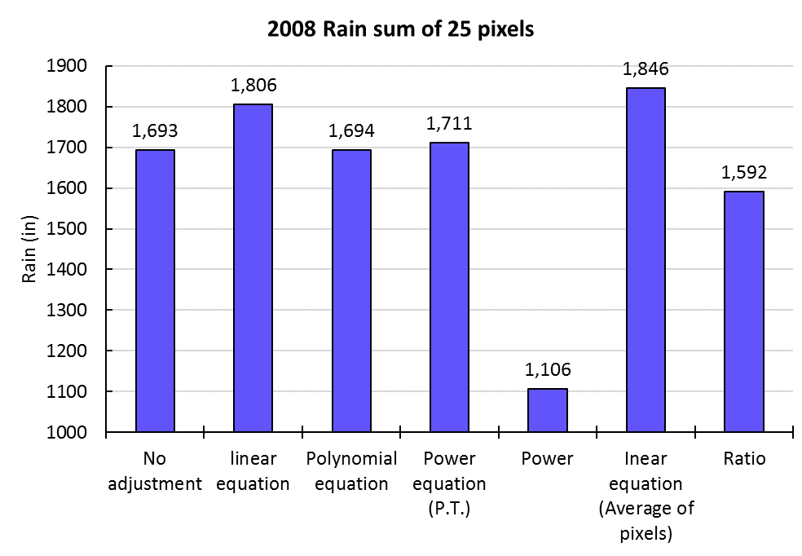
Adjustment Method Evaluation
(Based on the relationship between NEXRAD and rain gauge)
Notes:
The ratio correction (1:1) suggests that in comparison to the rain gauge, NEXRAD is overestimating rain within the pixel associated with the rain gauge and the surrounding pixels.
Most adjustment approaches tend to further overestimate and greatly underestimate (Power) the value of NEXRAD. Therefore, we believe that the ratio approach is the best choice to adjust the NEXRAD data.

Slide 6
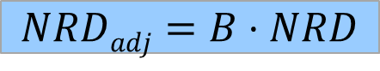
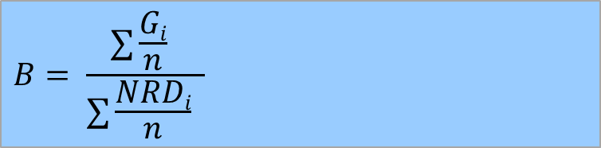
Adjustment Method
Rain gauge station selection:
Period: 1999 – 2016
Compared the rain gauge and corresponding NEXRAD
Calculated bias for each pair (gauge vs NEXRAD) yearly on rain gauges available:
Rain gauges with bias less than 0.8 or greater than 1.2, and n days less than 300 were omitted.
Adjusted NEXRAD was obtained:
$$B= \frac{∑\frac{Gi}{n} }{∑\frac{NRDi}{n} }$$
G= Rain gauge
NRD= NEXRAD pixel
n = number of days
$$NRDadj=B⋅NRD$$

Slide 7
Data Preparation Process
Developed R script:
Calculates annual bias multipliers from Rain Gage vs NEXRAD Pixels.
Bias factors at Rain Gages are interpolated using Ordinary Kriging producing an annual 'bias' raster.
Daily NEXRAD Pixels are rasterized and multiplied by the 'bias' raster to produce 'bias adjusted' Daily NEXRAD rasters.
Daily adjusted NEXRAD rasters converted back to pixels by extracting raster values.
Daily pixels values by row are combined as columns and exported to csv files.
Execution time approx. 10 minutes.
Notes:
While the R square coefficients appeared good for all periods except for daily, of greater concern is that the linear relationship holds closer to a 1:1.

Slide 8
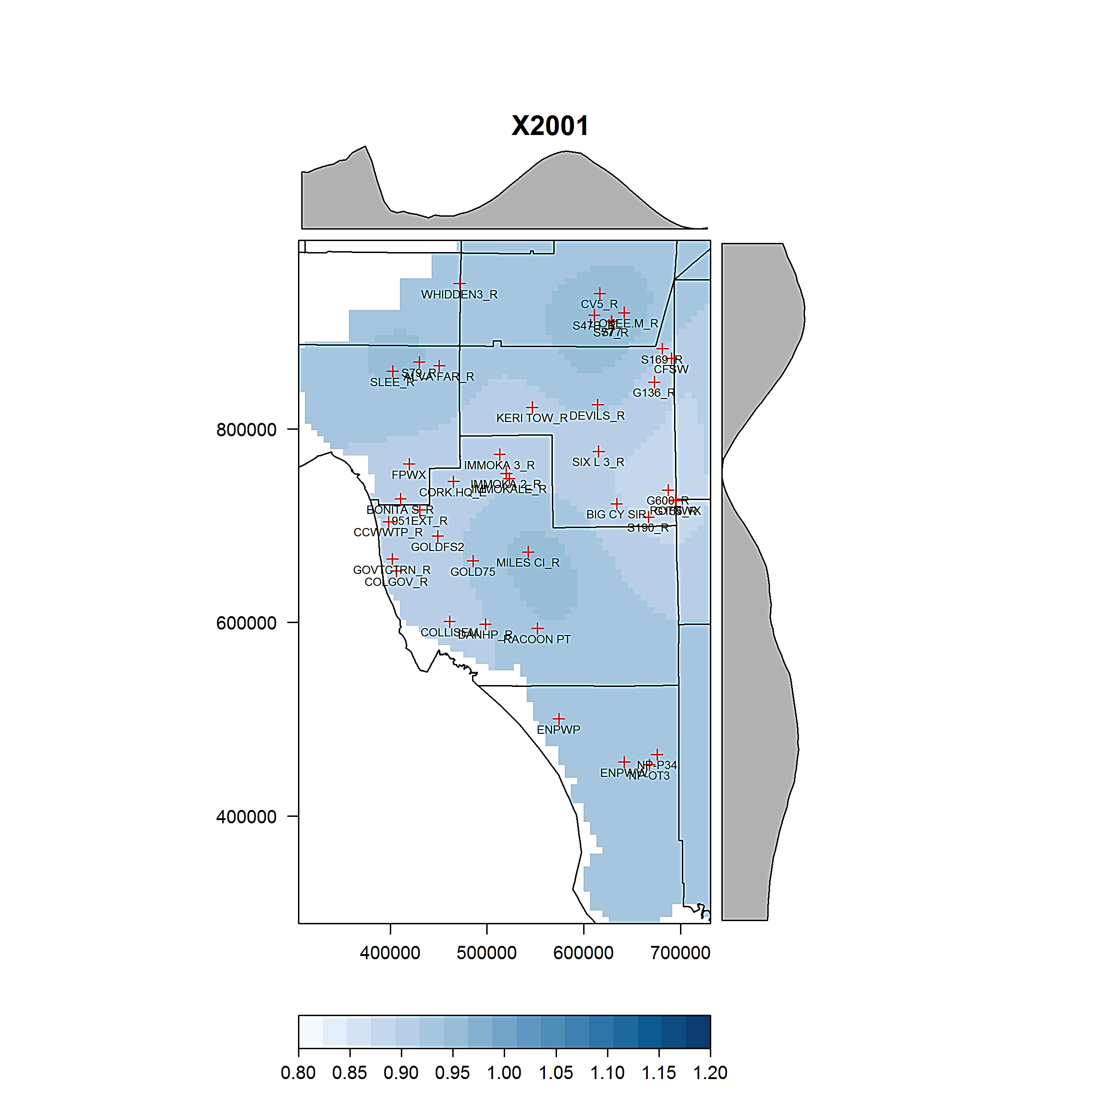
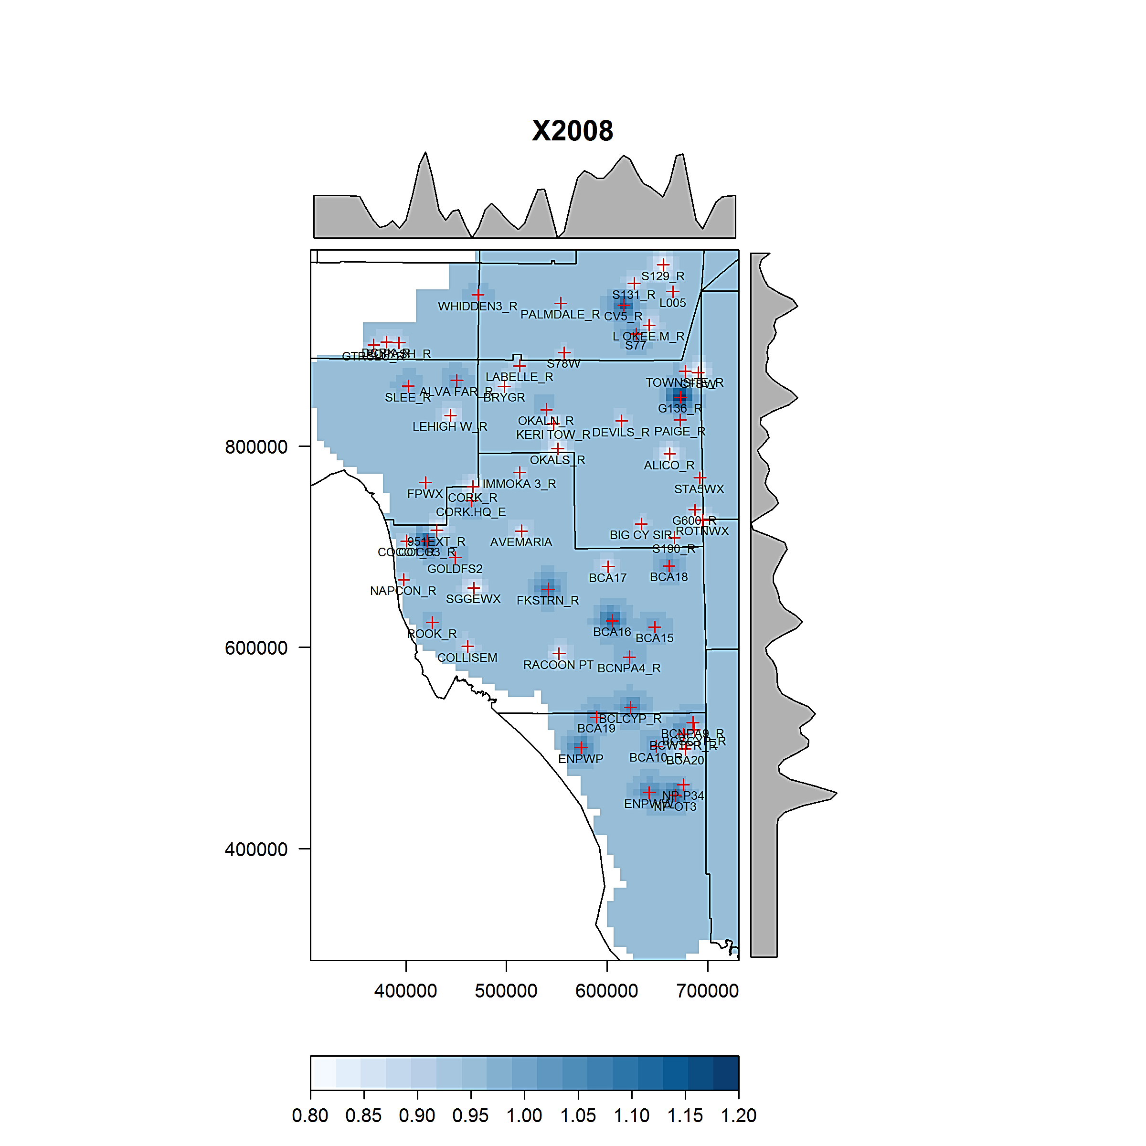
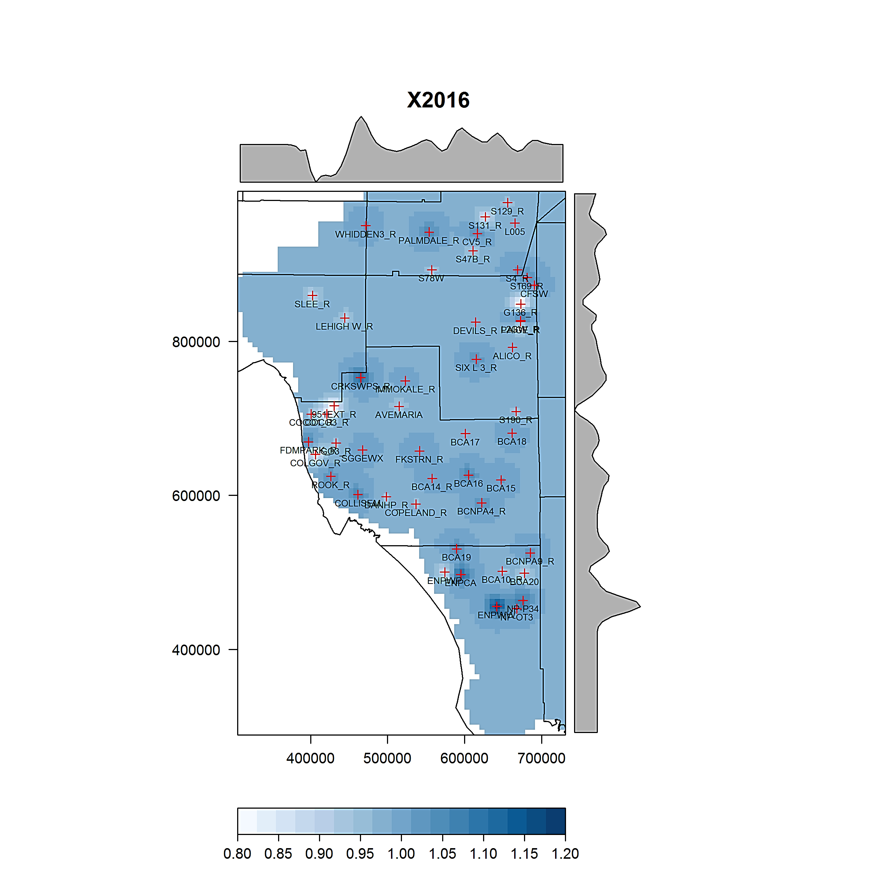
Interpolated Bias
Interpolated bias from rain gauges to NEXRAD pixels
Ordinary kriging
Notes:
Example of interpolated bias for three different years. Note that the number of rain gauges available and bias varies with year.

Slide 9
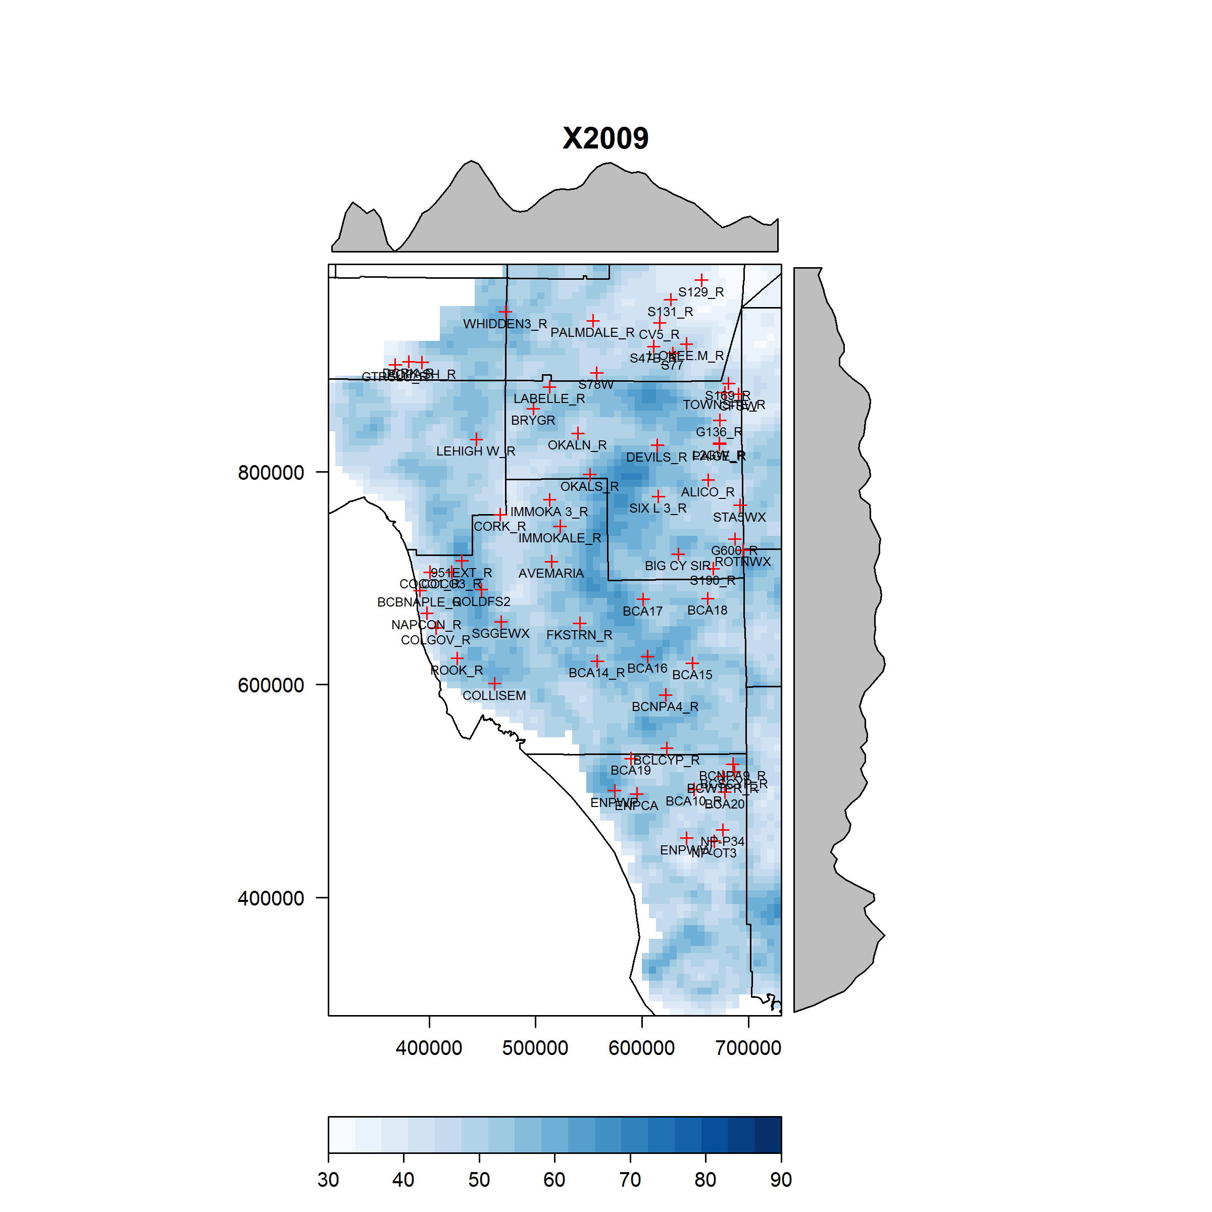
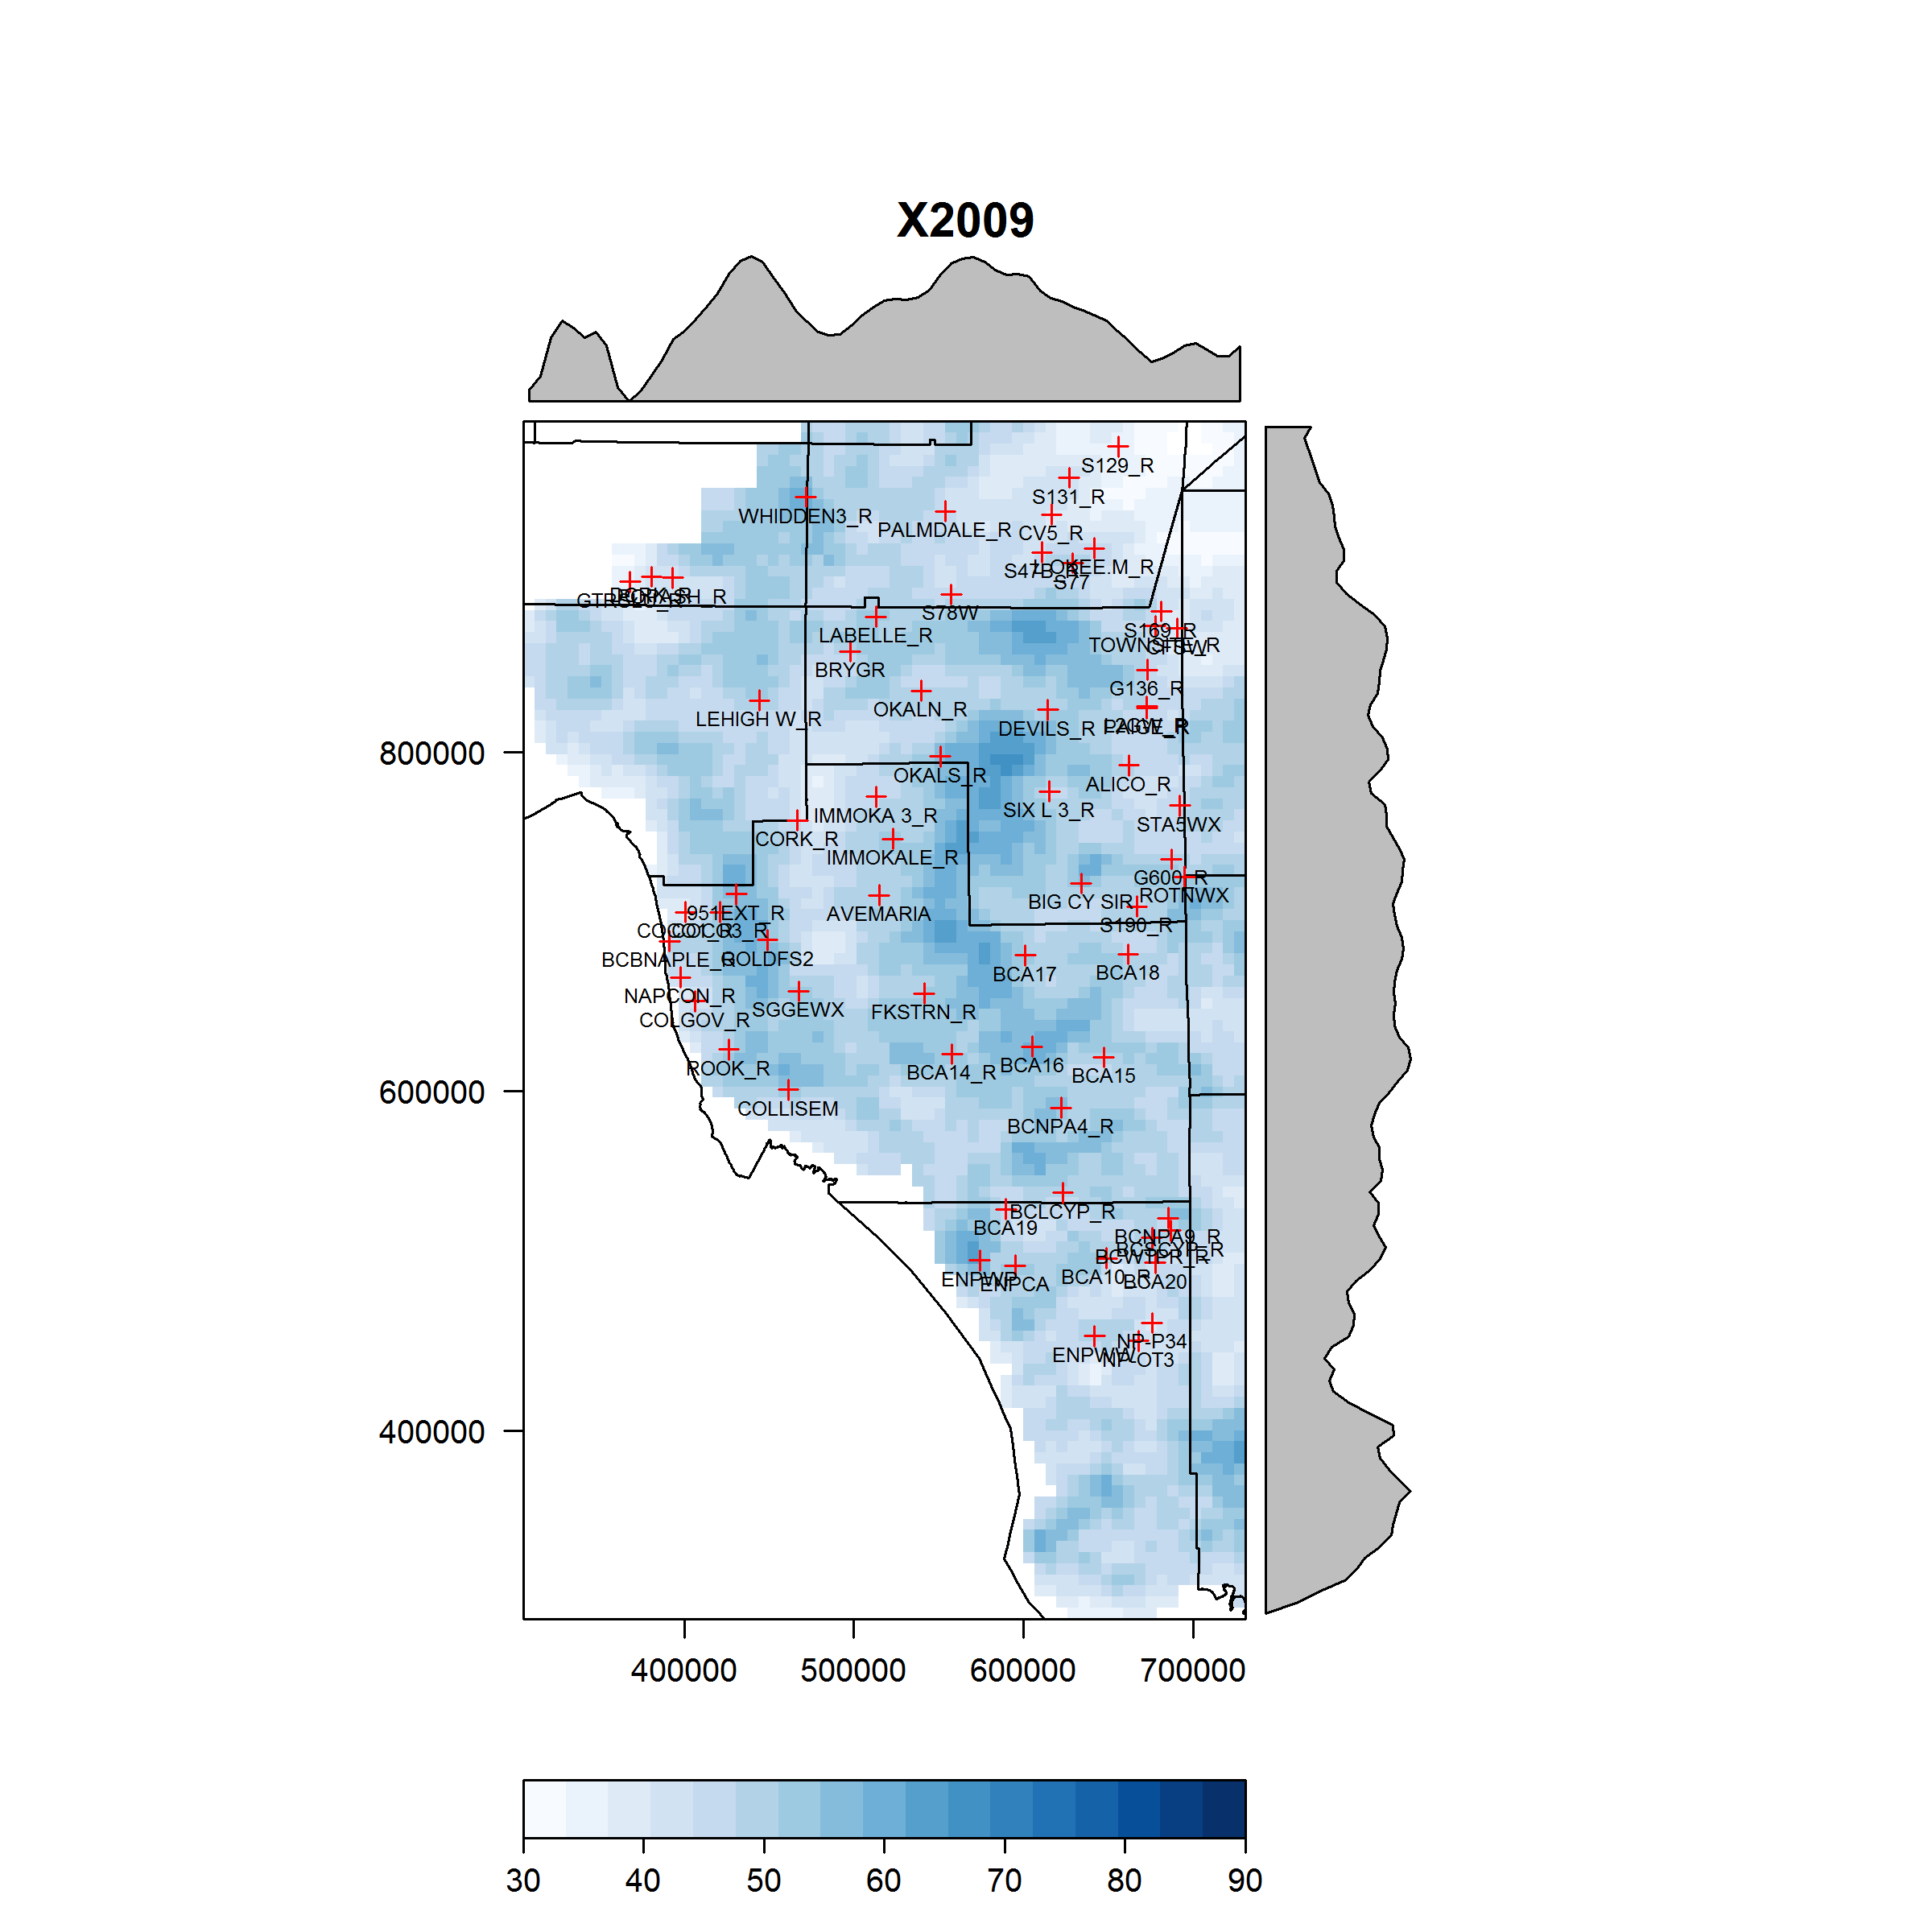
Comparison of NEXRAD vs Adjusted NEXRAD
NEXRAD
Adjusted NEXRAD
Notes:
Circles show some slight differences between the NEXRAD and the adjusted NEXRAD.
Overall, the NEXRAD adjustment did not greatly changed the spatial pattern but improved the data to make it more representative of ground (gauge) observation. In addition, the adjusted data performed significantly better than the unadjusted version during model runs.

Slide 10
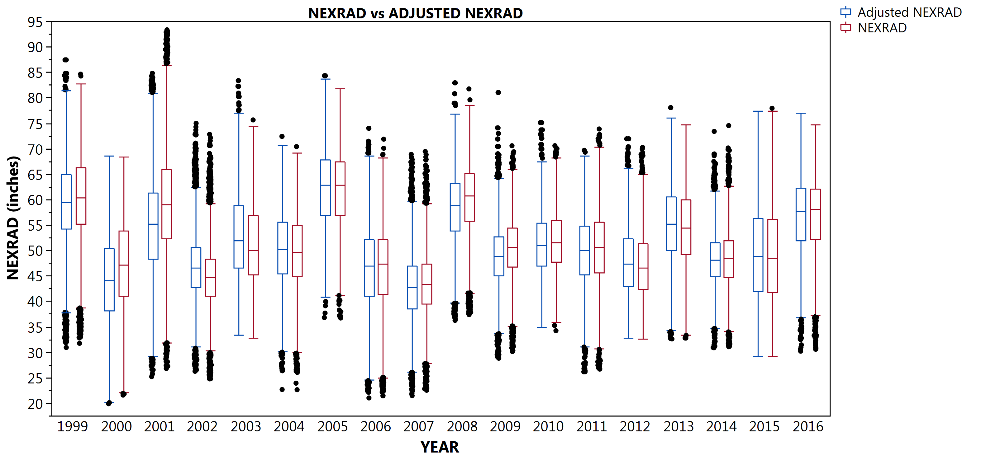
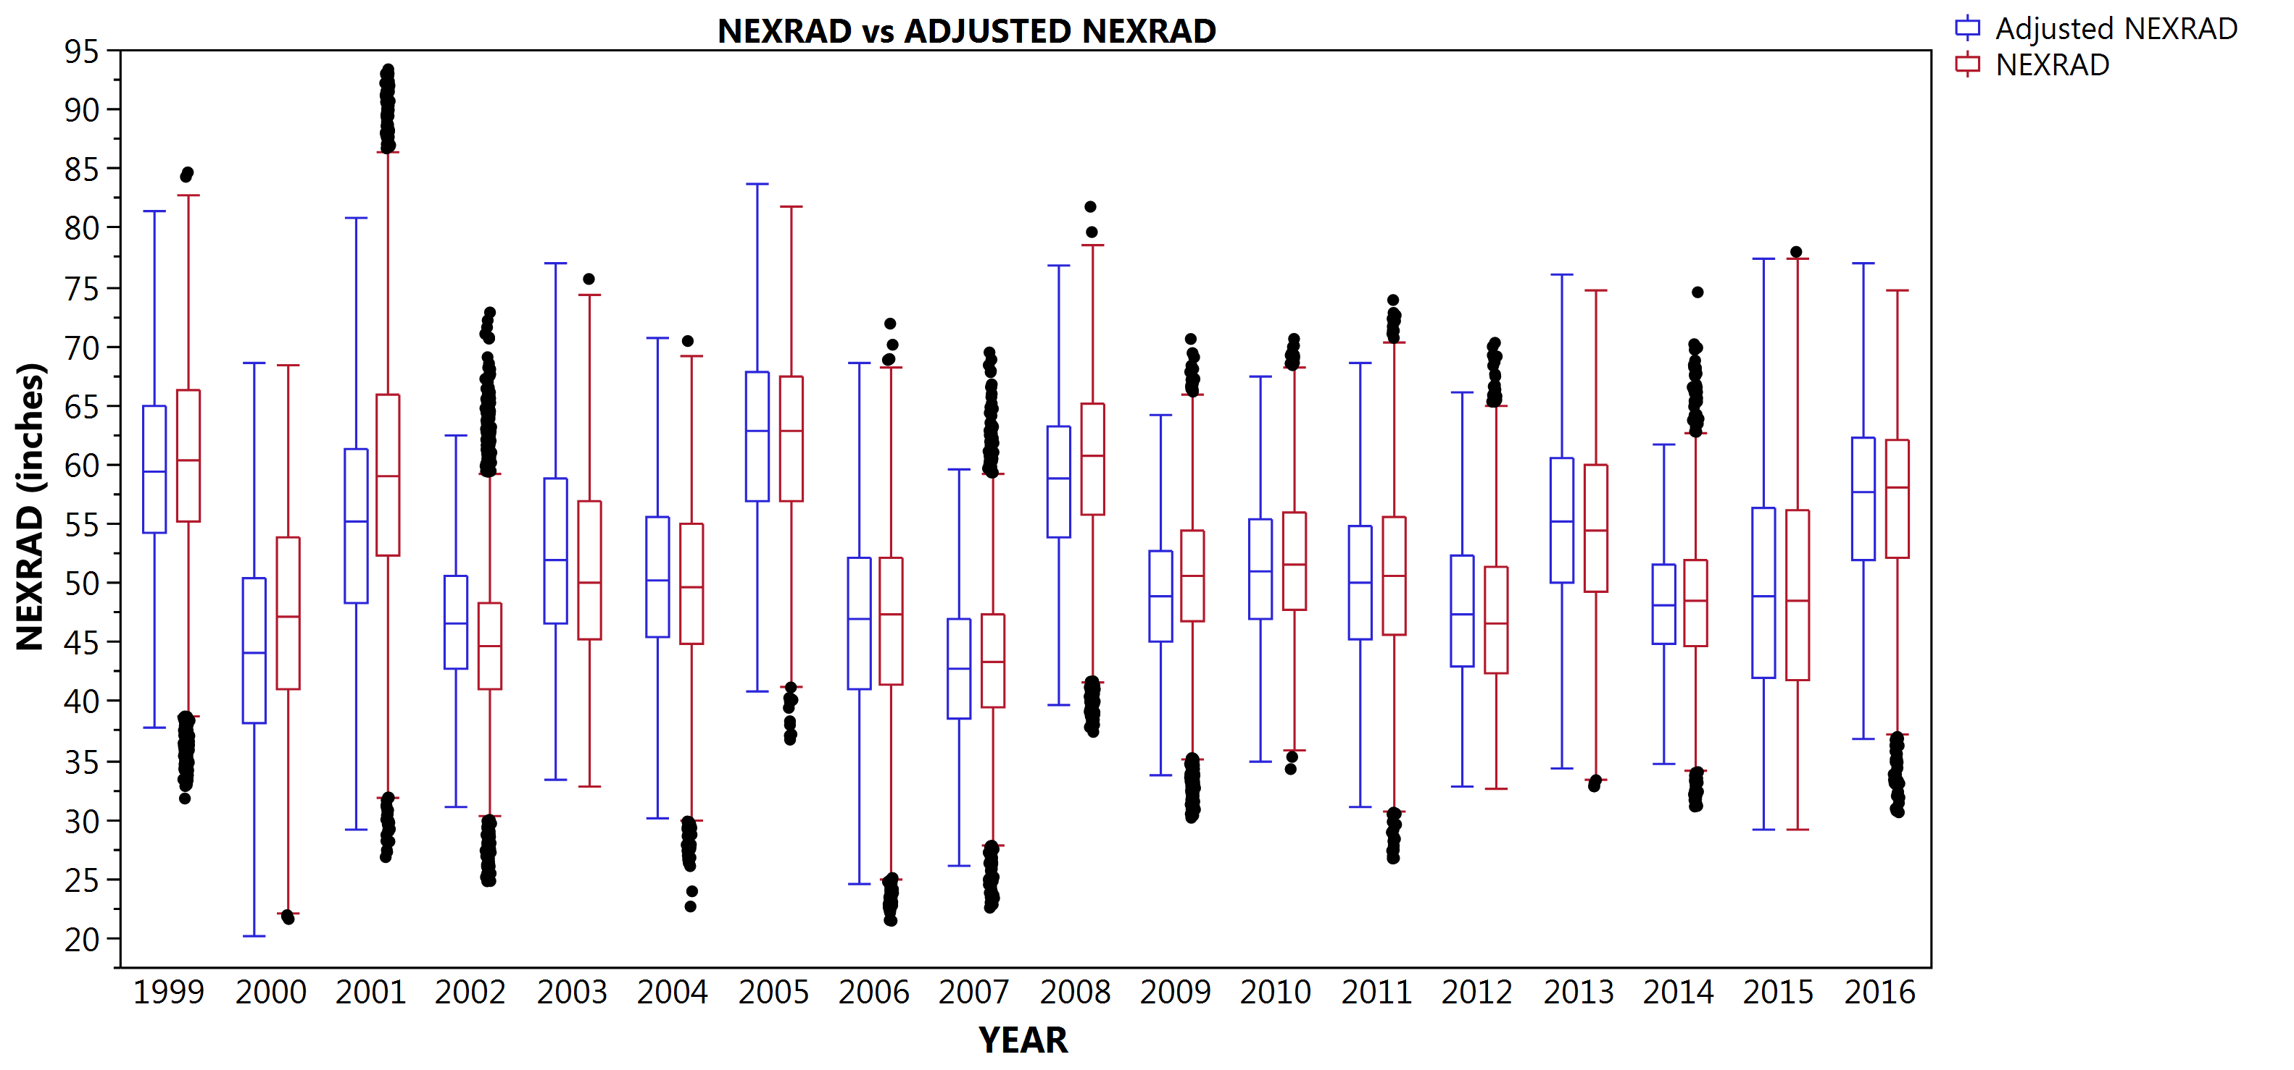
Comparison of NEXRAD vs Adjusted NEXRAD
(NS)
(NS)
(NS)
(NS)
ANOVA Significance (α = 0.05)
Notes:
While no drastic visual or apparent changes were observed from NEXRAD vs the adjusted NEXRAD, further analysis of the data indicated statistically significant differences between the NEXRAD and the adjusted NEXRAD for most years.

Slide 11
Summary and Conclusions
Significand differences in daily, monthly, and yearly, reported NEXRAD values vs rain gauge values.
Overall, NEXRAD overestimation and underestimation can be corrected by using bias factors derived from the rain gauge and corresponding NEXRAD pixel relationship.
Bias can be factor in for entire grids using spatial interpolation methods.
Finally, this correction can be expedite (by reducing the amount of time to process the data) using a multi-process approach in R.

